Slide 1

Introduction to AI

Slide 2
Table of content
AI story
Difference between AI, ML and DL
Supervised, Unsupervised and Reinforcement Learning
Popular languages and frameworks for ML
Machine Learning applications

Slide 3
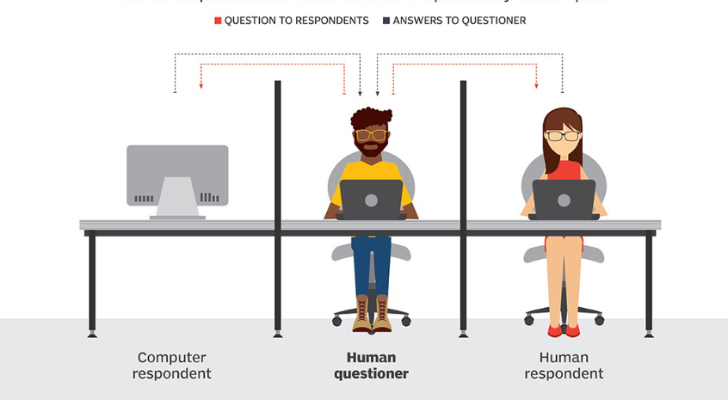
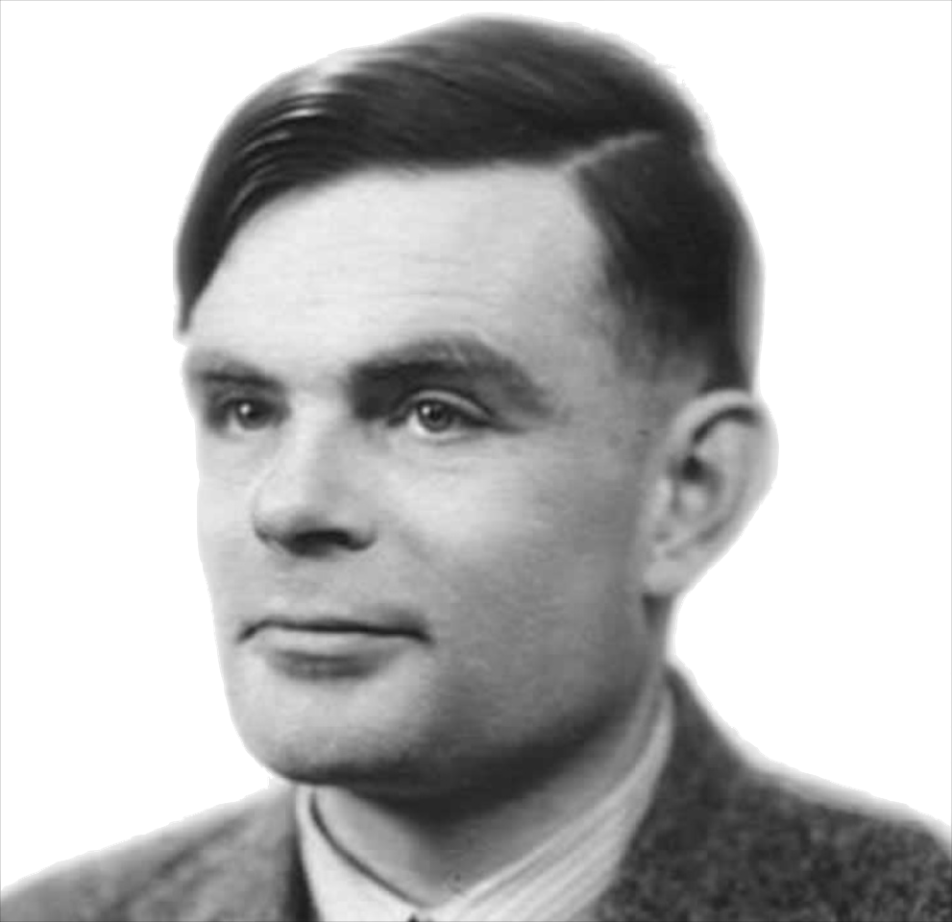
AI STORY
1950
Alan Turing: "Can machines think?"
Systems that think like humans
Systems that act like humans
Systems that act rationally

Slide 4
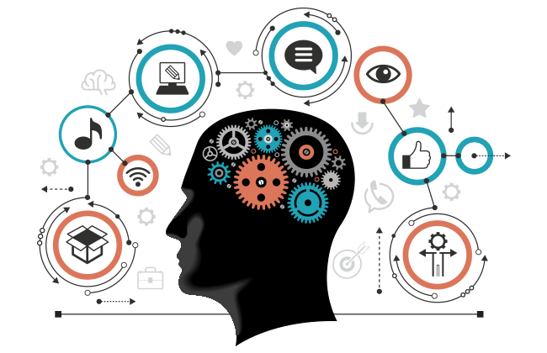
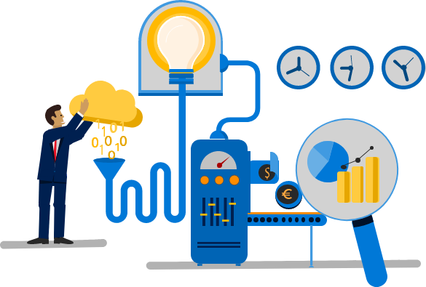
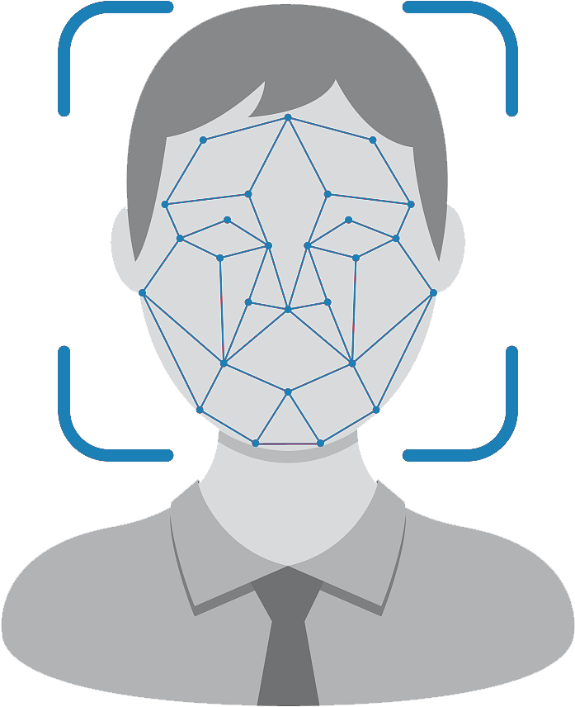
DL
ML
AI

Slide 5
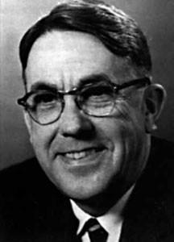

Machine Learning - ML
1962
“machine learning is a field of study that gives computers the ability to learn without being explicitly programmed”
Arthur Samuel
invented the term
"machine learning" 1959
Robert Nealey, the self-proclaimed
checkers master, lost to the computer.

Slide 6
Deep Learning - DL
Confidentiel © DeepFlow 2022

Slide 7
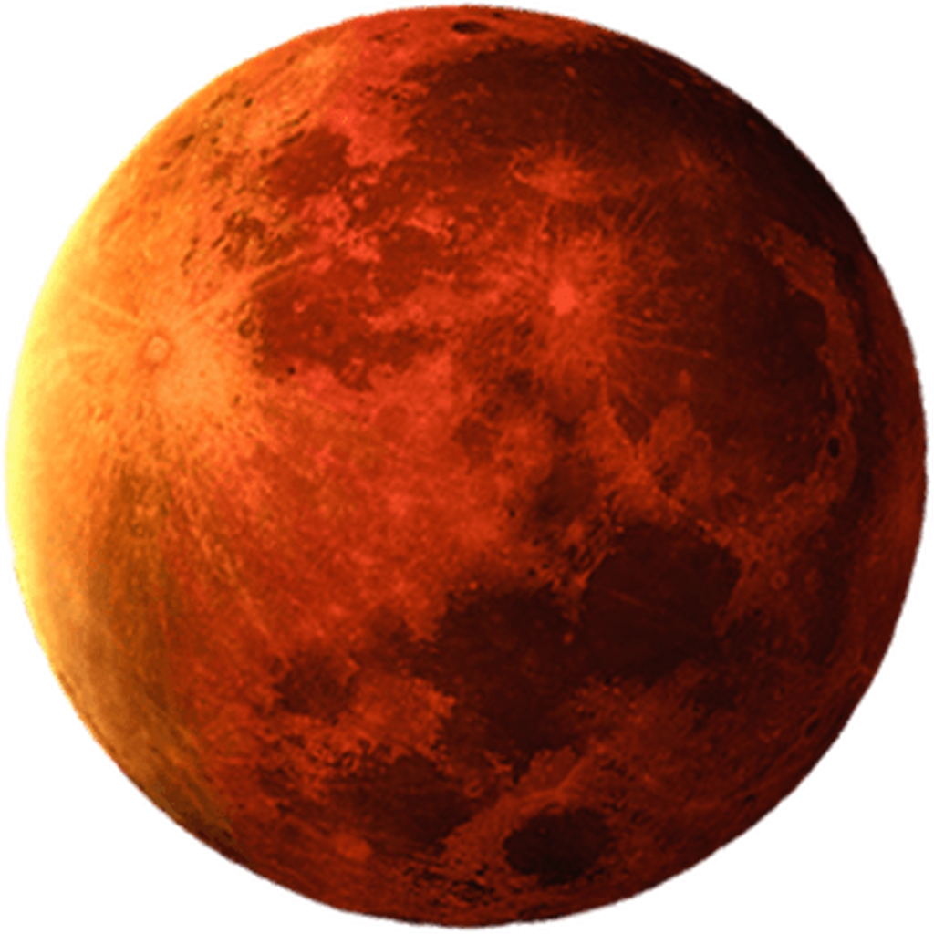
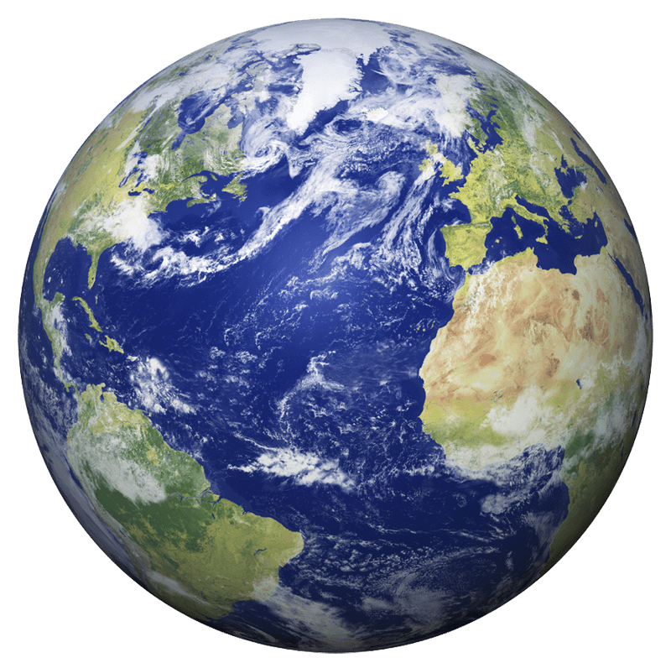
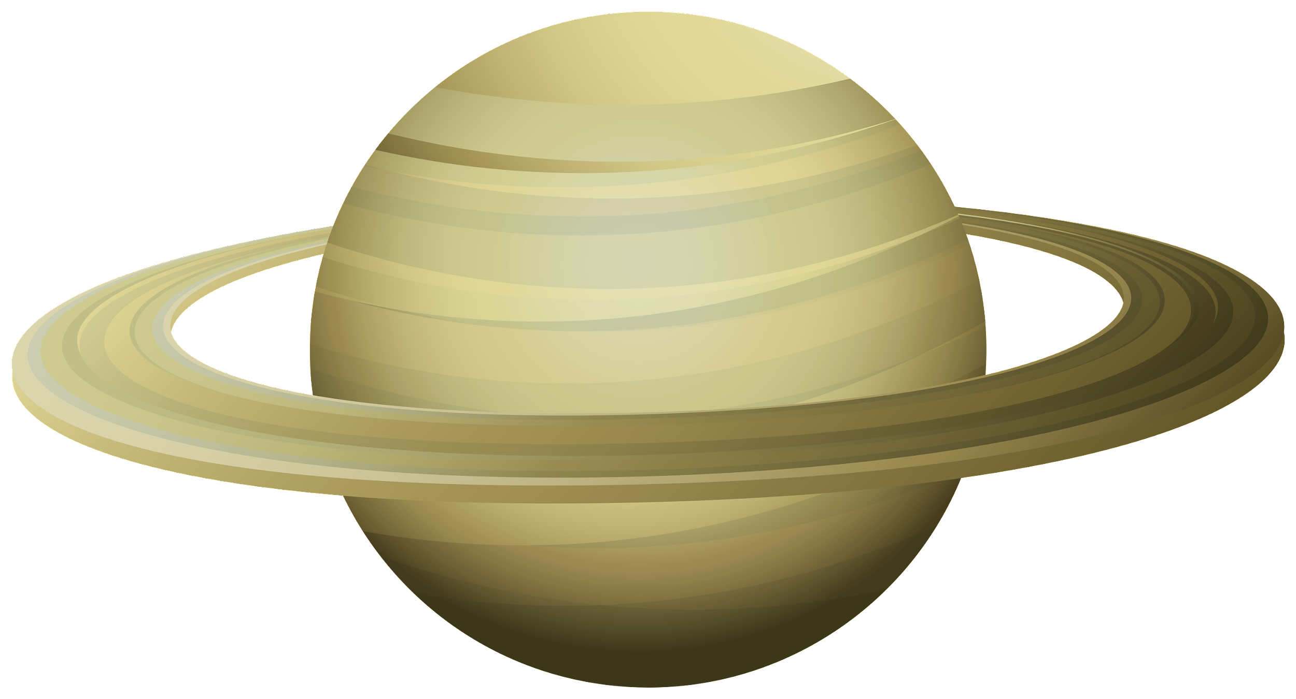
Mars
Earth
Saturn
Supervised
Earth
Saturn
Mars
Saturn
Unsupervised

Slide 8
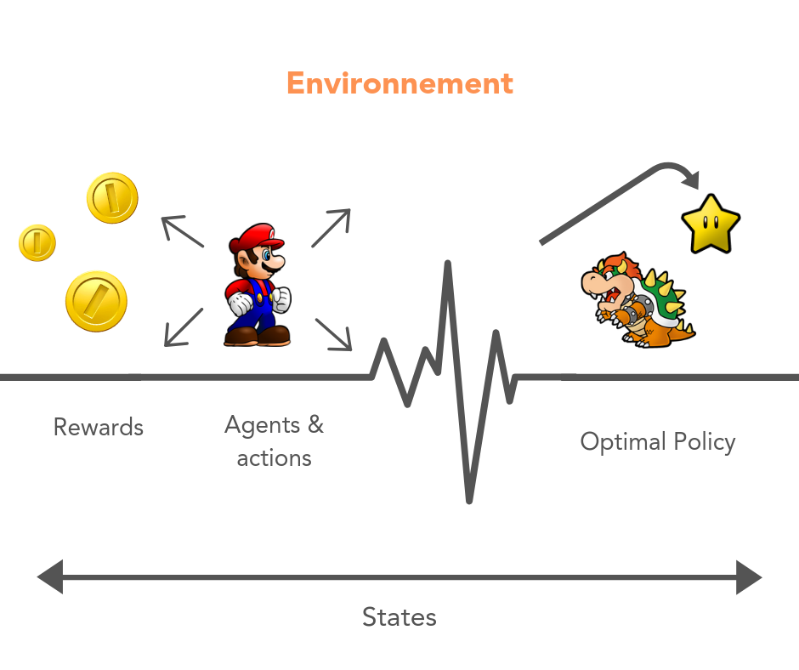
Reinforcement Learning

Slide 9


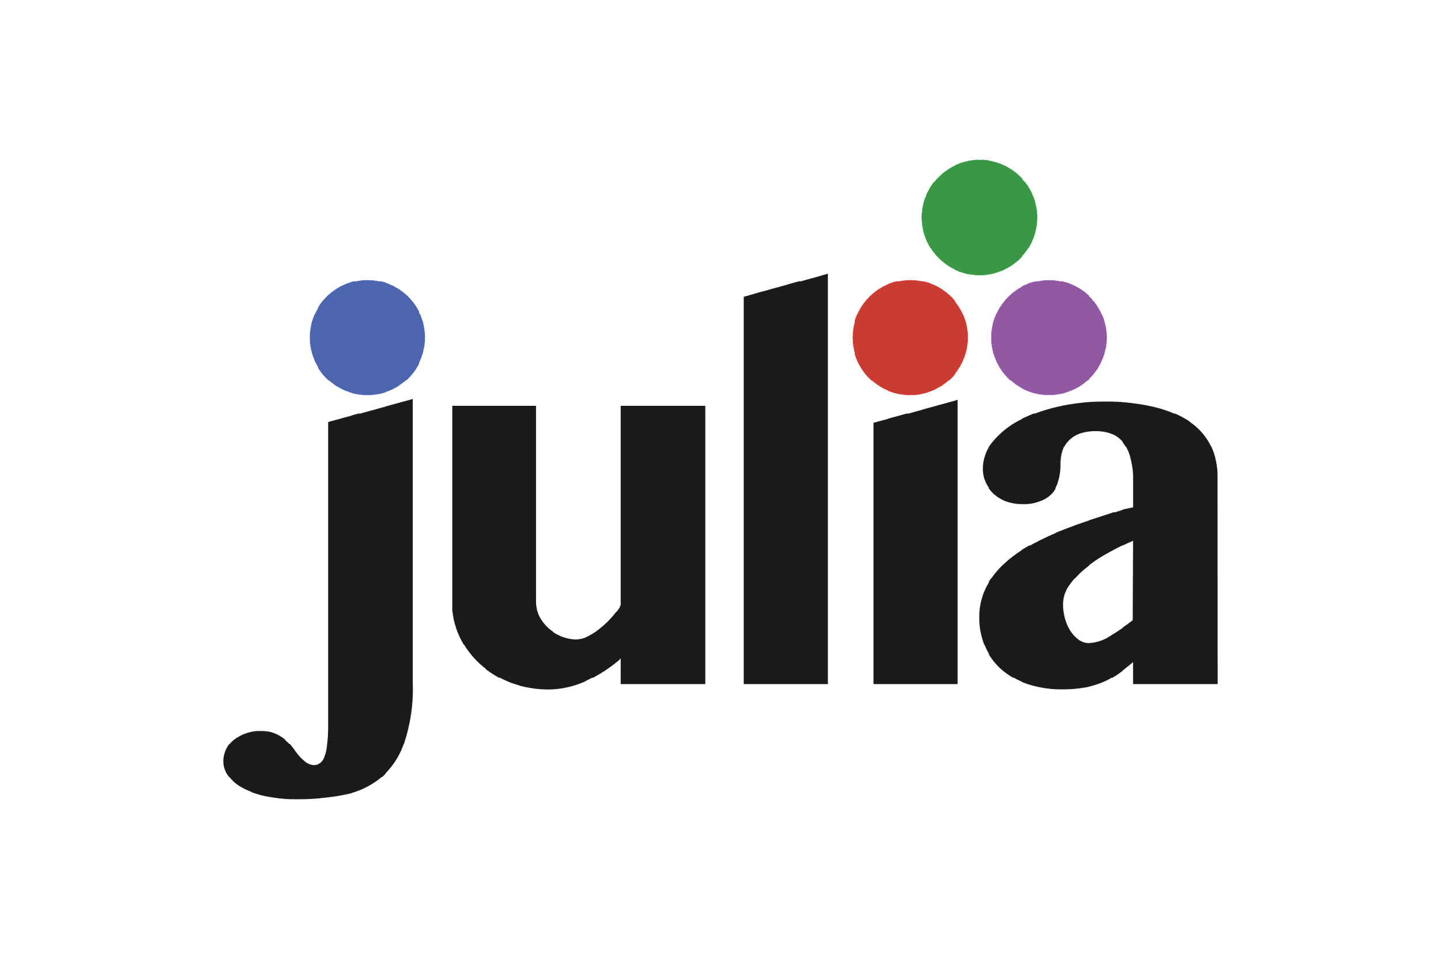
Popular Languages

Slide 10




Frameworks

Slide 11
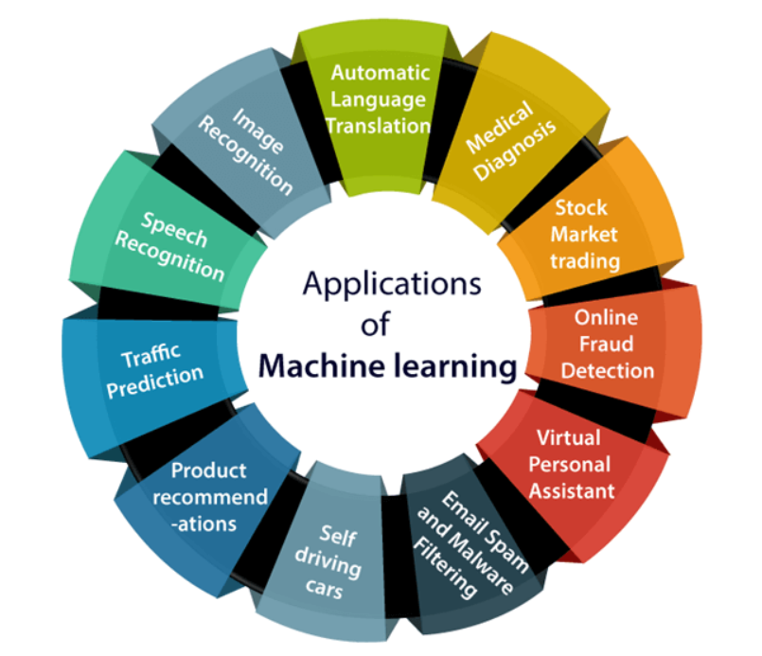
ML Applications

Slide 12
Thank you for your attention

